Slide 1
Information security
Presentation made by Tadas Laurinaitis

Slide 2
Outline
Introduction
Definition
History
Computer security
Definition
Threats
Defenses
Antivirus software
Definition
Usage
Charts
Myths and facts
Conclusion

Slide 3

definition
Information security (shortened to InfoSec) - practice of preventing unauthorized access, use, disclosure, disruption, modification, inspection, recording or destruction of information.
Subcategories of information security:
Internet security
Cyberwarfare
Computer security
Mobile security
Network security

Slide 4
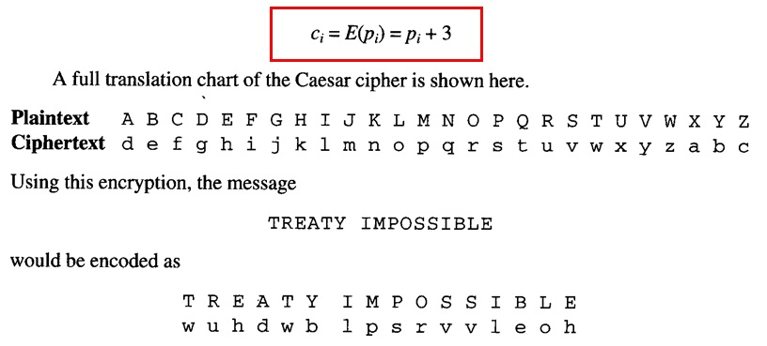
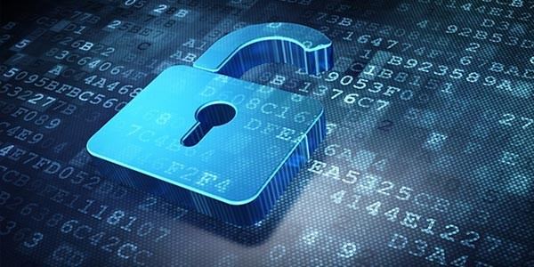
History
Caesar ciphre

Slide 5
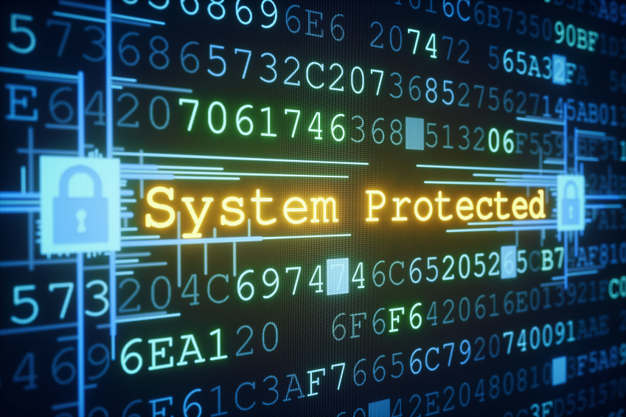
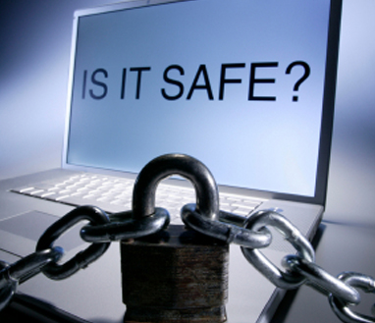
Computer security
Computer security - protection of computer systems from the theft and damage to their hardware, software or information, as well as from disruption or misdirection of the services they provide.
The field is of growing importance due to the increasing reliance on computer systems, the Internet and all devices which belong to IOT (Internet Of Things)

Slide 6
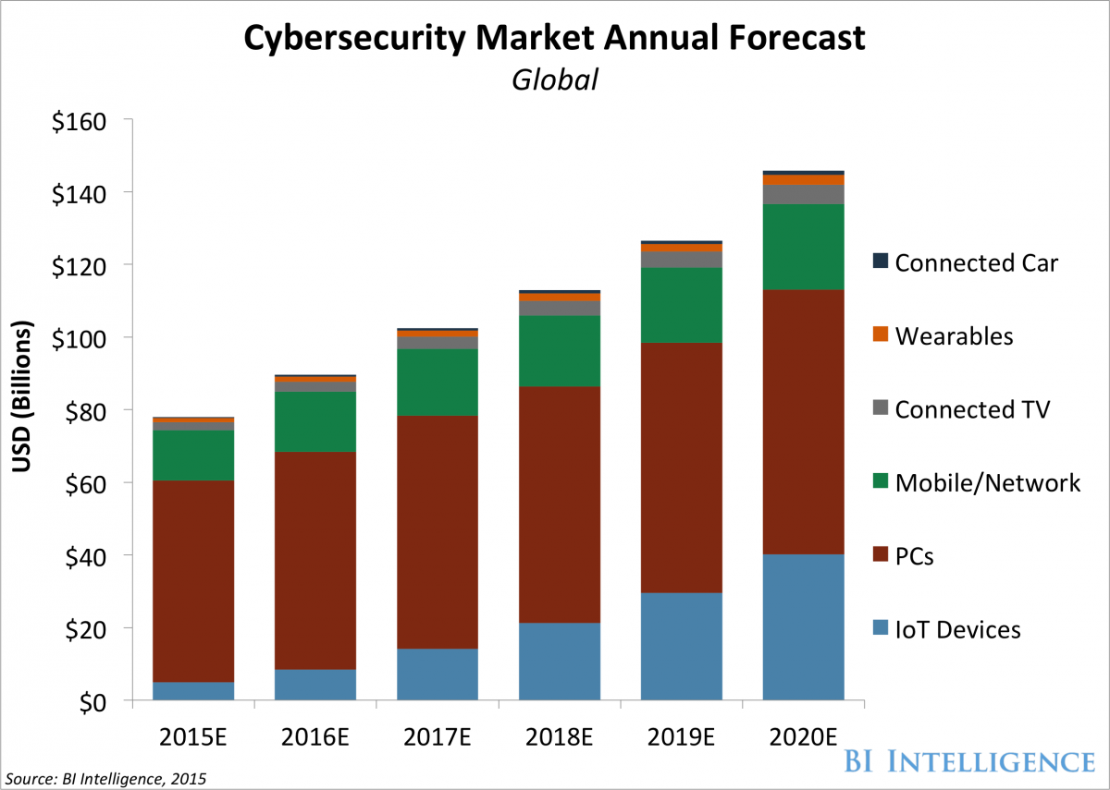
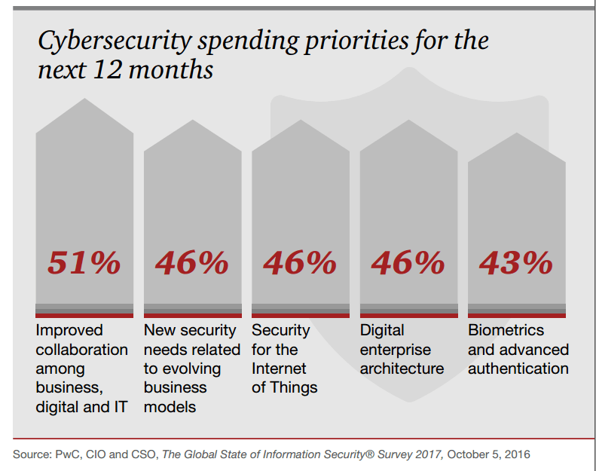
computer security CHARTS
Source: http://www.businessinsider.com/cybersecurity-report-threats-and-opportunities-2016-3
Source: https://heimdalsecurity.com/blog/10-critical-corporate-cyber-security-risks-a-data-driven-list/

Slide 7
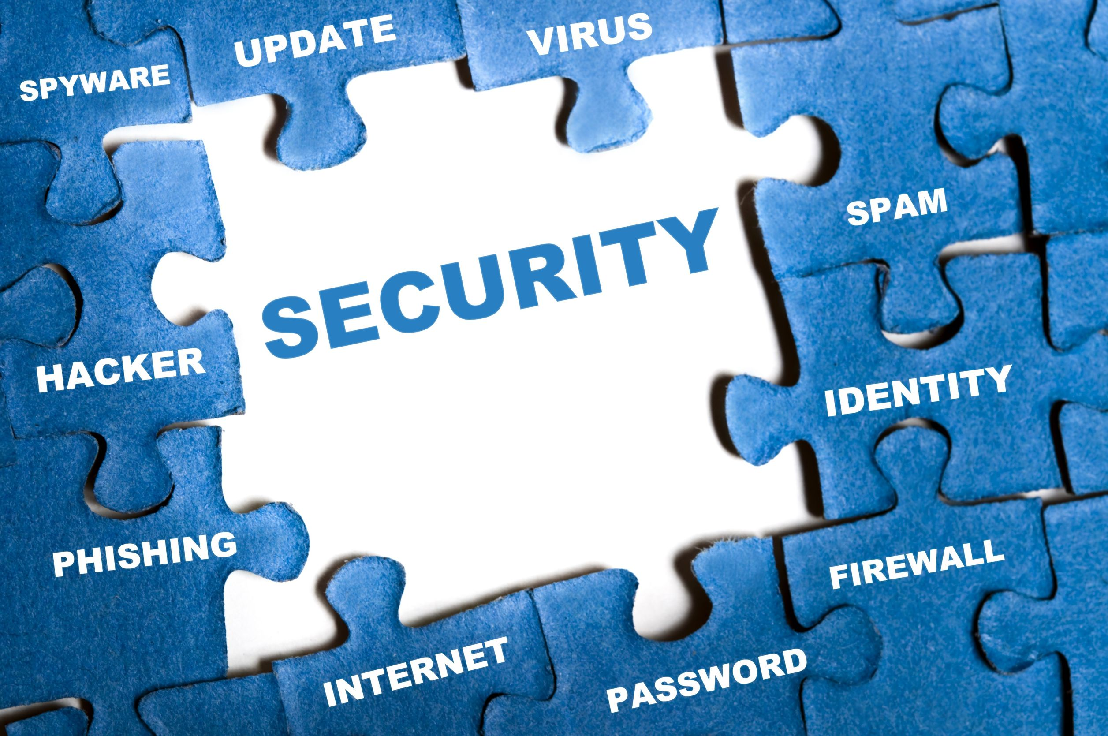
Threats
Computer crime
Eavesdropping
Malware
Spyware
Ransomware
Trojans
Viruses
Worms
Keyloggers
Exploits
Backdoors
Logic bombs
http://www.informationisbeautiful.net/visualizations/worlds-biggest-data-breaches-hacks/

Slide 8

Defenses
Application security
Antivirus software
Secure coding
Security by design
Secure operating systems
Authentication
Multi-factor authentication
Authorization
Data-centric security
Firewall (computing)
Intrusion detection system
Intrusion prevention system
Mobile secure gateway

Slide 9
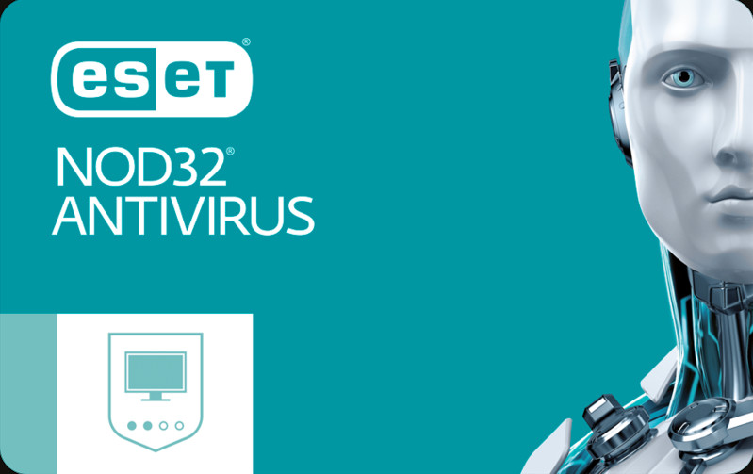


Antivirus software
Antivirus software - computer software used to prevent, detect and remove malicious software.
Modern antivirus software can protect from: malicious browser helper objects (BHOs), browser hijackers, ransomware, keyloggers, backdoors, rootkits, trojan horses, worms, malicious LSPs, dialers, fraudtools, adware and spyware.

Slide 10
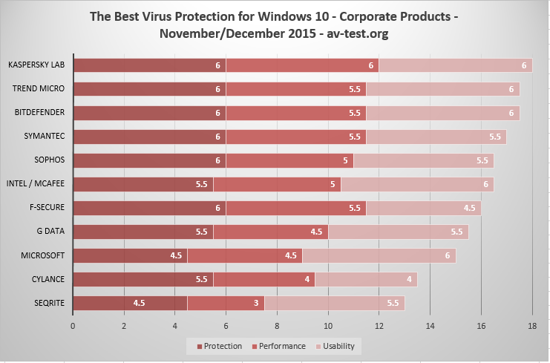
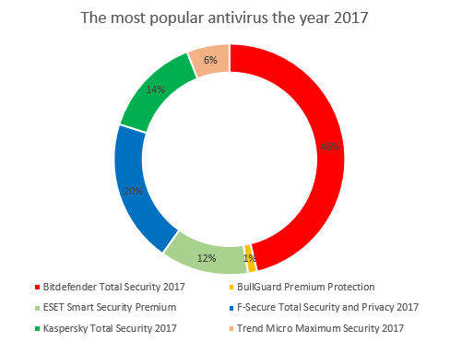
Best and most Popular antivirus software
Source: https://www.pcworld.com/article/3025889/windows/tested-microsofts-windows-defender-antivirus-is-less-awful-than-it-used-to-be.html
Source: http://www.digitalcitizen.life/digital-citizen-awards-most-popular-antivirus-product-year-2017

Slide 11
Antivirus myths and facts
Myth
Fact
1. Antivirus software can only detect specific, known viruses.
2. If an antivirus has flagged or blocked a file, this file is definitely malware.
3. Testing an antivirus solution should be done by throwing as many viruses at it as possible
1. Antivirus engines today use a variety of approaches and technologies to detect malware, especially as-yet-unseen malware.
2. Files may be mistakenly blocked, even if they do not contain viruses or other threatening code.
3. Whenever an antivirus product is evaluated, it is important to test with a mix of good files and malware to ensure that the product not only detects viruses, but that it also does not generate false positives, or at least a very low number.

Slide 12
Conclusion
1. Bigger usage of computer systems leads to bigger security concerns
2. Information security has to be up to date to be less vulnerable to threats
3.

Slide 13
Sources
http://www.commtouch.com/uploads/pdf/Antivirus-Myths-and-Facts.pdf
https://en.wikipedia.org/wiki/Information_security#History
https://en.wikipedia.org/wiki/Computer_security
https://en.wikipedia.org/wiki/Antivirus_software
https://en.wikipedia.org/wiki/Caesar_cipher

Slide 14


